Slide 1
Microlensing detection
With RNN and hybrid model

Slide 2
Introduction
Microlensing event: sudden increase in light magnitude due to gravitational lensing effect on light
Can reveal exoplanets that are harder to detect in other techniques
Idea: build anomaly detector to sense the onset of the microlensing event from the time series data of magnitudes.
Existing hybrid approach: ARIMA+RNN and GP+RNN to train the predictor, and alert if the discrepancy between prediction and real is bigger than a set threshold
Our idea: end-to-end alert system. use RNN to emit probability

Slide 3
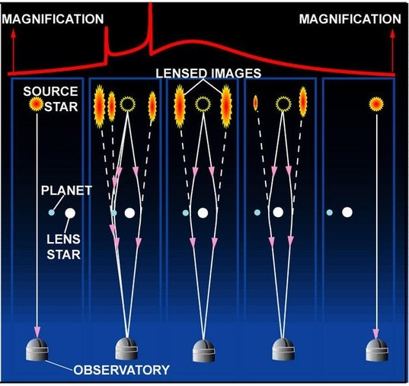
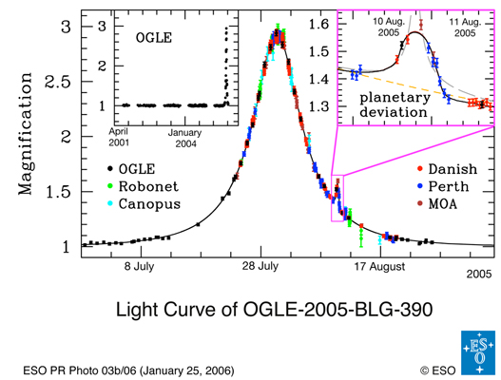
Use of Microlensing in Exoplanet Detection
Source: https://www.planetary.org/explore/space-topics/exoplanets/microlensing.html

Slide 4
Challenge - not enough labelled data
Recent data from GWAC not open to public yet
Sun Y., Zhao Z., Ma X., Du Z. Hybrid Model for Efficient Anomaly Detection in Short-timescale GWAC Light Curves and Similar Datasets. Proceedings of the Institute for System Programming, vol. 31, issue 2, 2019, pp. 33-40. DOI: 10.15514/ISPRAS-2019-31(2)-3.
Resort to generating simulated data to train, and visually inspect the performance on the real data

Slide 5
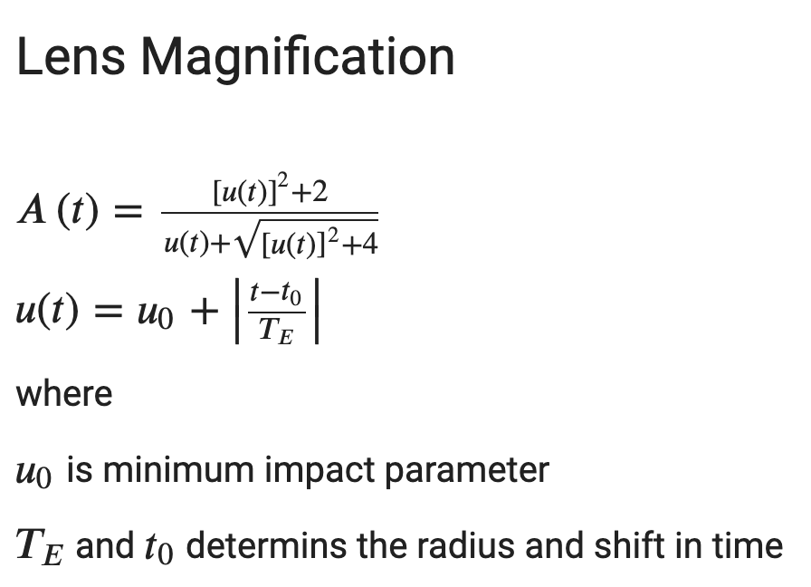
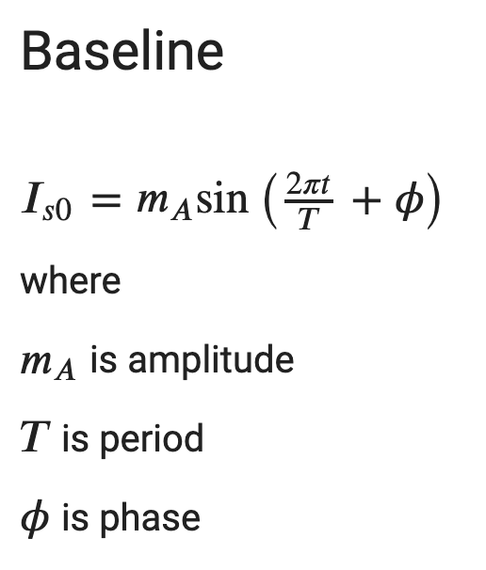
Data Generation
Qiu, Jiaming & Sun, Yankui & Wu, Chao & Du, Zhihui & Wei, Jianyan. (2018). NFD: Toward Real-time Mining of Short-timescale Gravitational Microlensing Events. Publications of the Astronomical Society of the Pacific. 130. 104504. 10.1088/1538-3873/aada6f.
Data = Baseline + Lens Magnification + Noise

Slide 6
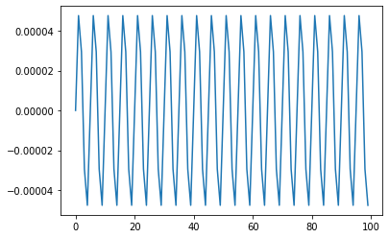
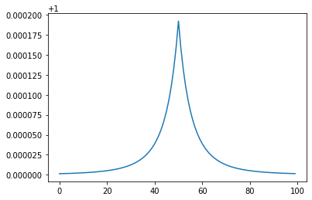
Data Generation

Slide 7
Data Generation
Randomize lens radius and shift
Labelling: Set radius * 1.5 before and after the shift to be anomaly
Use first 20% of data to normalize the data afterwards

Slide 8
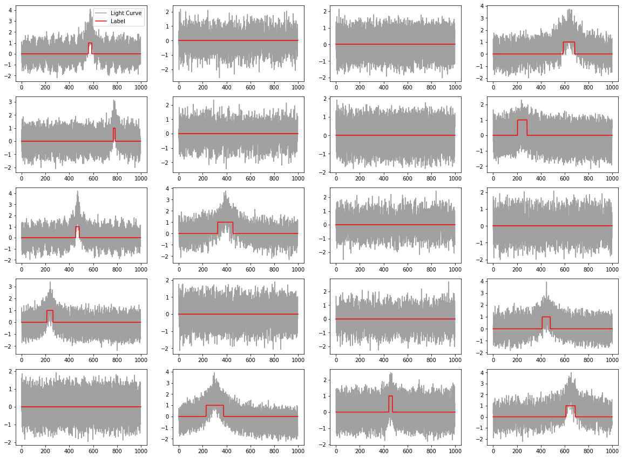

Slide 9
RNN architecture and training
20% Dropout rate
Adam optimizer
learning_rate=0.001, beta_1=0.9, beta_2=0.999 (Keras default)
Binary classification loss
Four models
LSTM(h=200, tanh) -> FC(1, sigmoid)
LSTM(h=200, tanh) -> LSTM(h=100, tanh) -> FC(1, sigmoid)
GRU(h=200, tanh) -> FC(1, sigmoid)
GRU(h=200, tanh) -> GRU(h=100, tanh) -> FC(1, sigmoid)
Training set: 500, each with 1000 time segment
Test set: 100, each with 1000 time segment
Dev set: 100, each with 2000 time segment
Learning curve metric: F1 against predictions on each time segment.
Performance characteristic on Dev set: Precision-Recall graph (vs. threshold), and F1 score derived from the graph

Slide 10
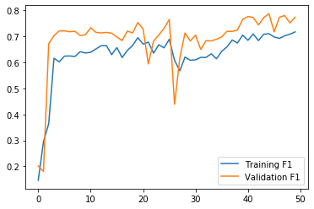
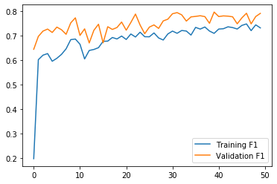
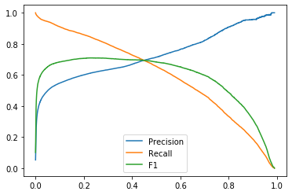
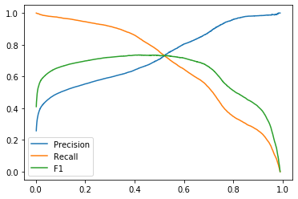
LSTM models
LSTM 1:
Best F1 0.7097
Threshold 0.24
LSTM 2:
Best F1 0.7358
Threshold 0.41

Slide 11
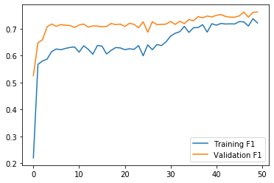
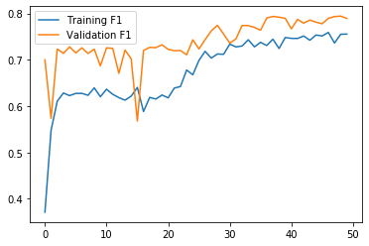
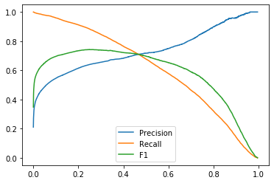
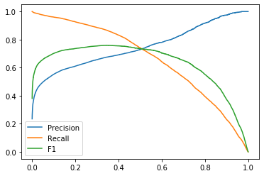
GRU models
GRU 1
Best F1 0.7428
Threshold 0.26
GRU 2
Best F1 0.7592
Threshold 0.34

Slide 12
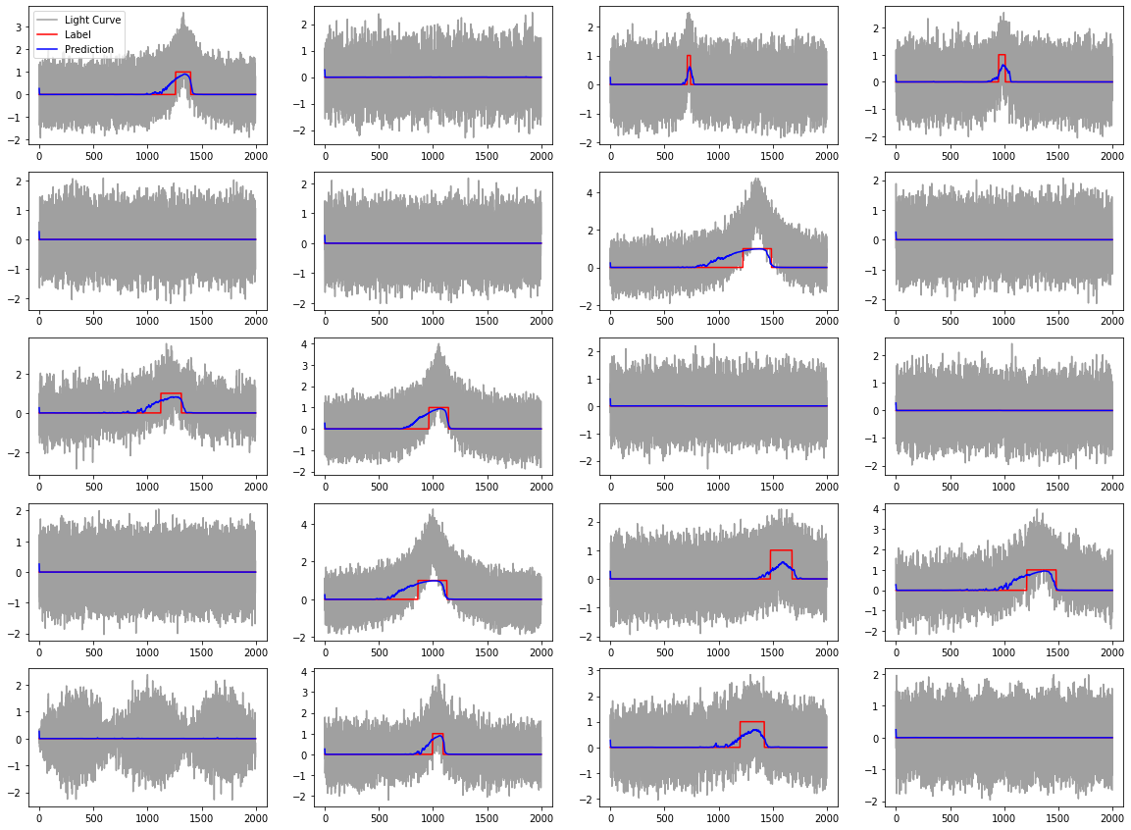
GRU 2 dev set sample

Slide 13
Real data - MOA
Microlensing Observations in Astrophysics (MOA) Survey
https://exoplanetarchive.ipac.caltech.edu/docs/MOAMission.html
Light curve data in flux. Converted to AB magnitude, then inverted to give light amplitude.
Used alert data to filter for graphs with microlensing event(s) from Field #18
Normalized with first 20% of data.
Filled in zeroes for NaNs.

Slide 14
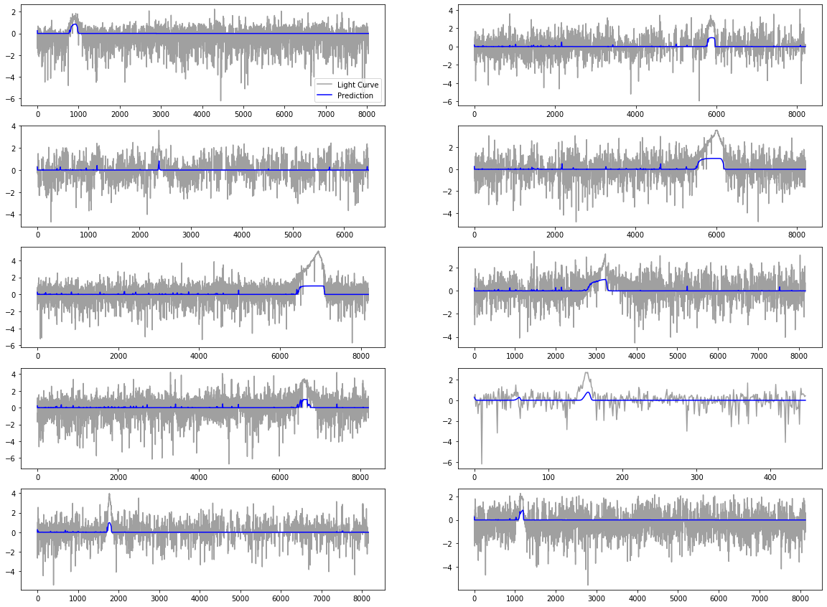
GRU 2 prediction on MOA

Slide 15
Simulation to Real data
Simulation parameters are informed by the performance of the model on the real data set.
Case in point - Randomization of lens radius
Two train datasets used to train GRU 2:
T1: Fixed radius
T2: Random lens radius
GRU 2 trained T1 tend to overfit to the radius length, and does not generalize to real data with variable lens length
Prediction results on GRU 2 on T1 and T2 are presented in next two slides

Slide 16
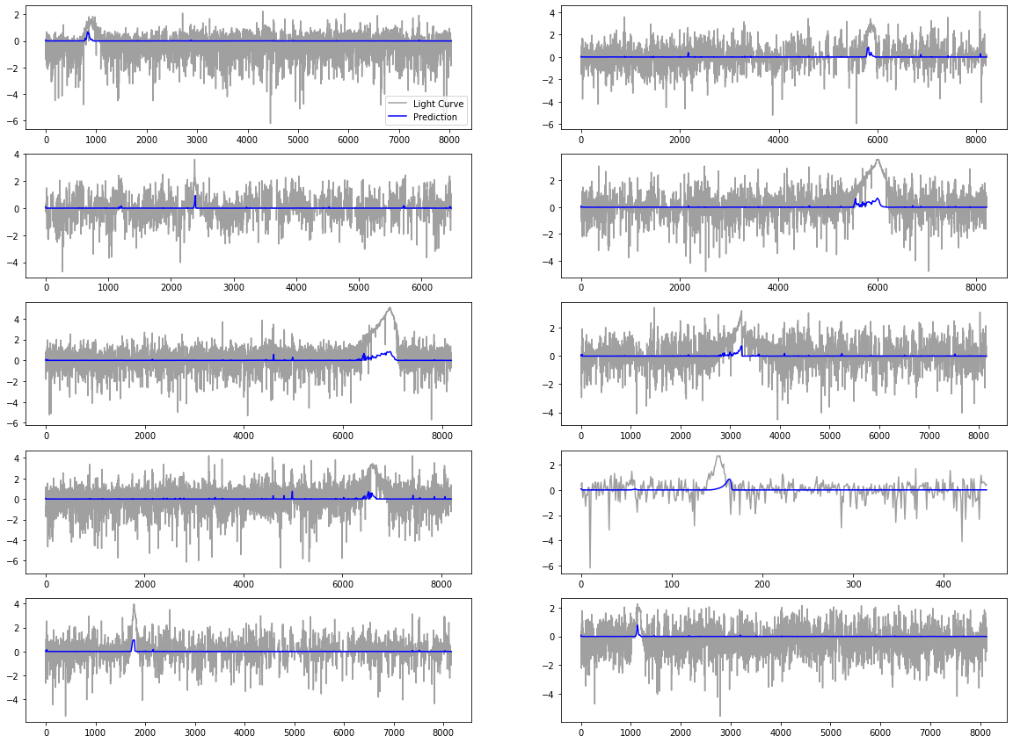

Slide 17
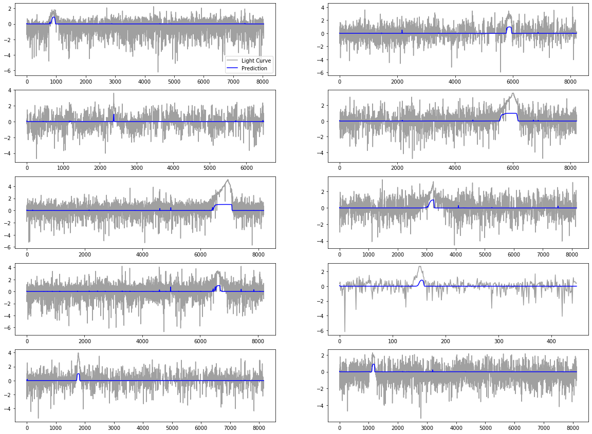

Slide 18
ARIMA
Models
Data & Prediction plot
Simulation Results
MOA Results

Slide 19
ARIMA - Models
Learned on 20% of data and predict the remaining 80% using rolling in-sample predictions
Took predictions or residuals and concatenate with data to feed into RNN
RNN now takes 2 data channels
Trained and fit several models
ARIMA (0,0,1)
ARIMA (0,0,2) - Best performing
ARIMA (1,0,0)
ARIMA (1,0,1)
ARIMA (1,1,1) - Predictions explode
What worked best was a simple ARIMA model that amplified the microlensing signals in the data

Slide 20
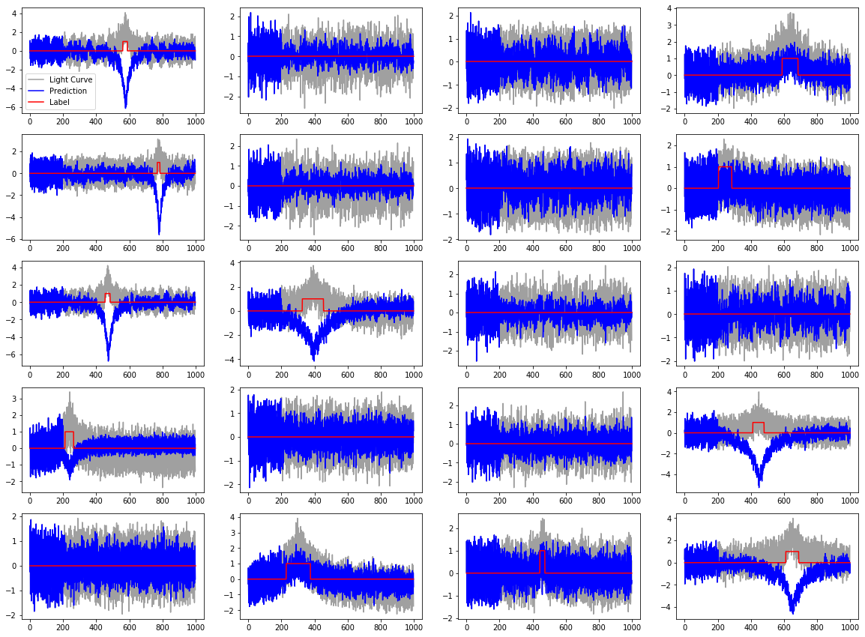
ARIMA (0,0,1) - Prediction

Slide 21
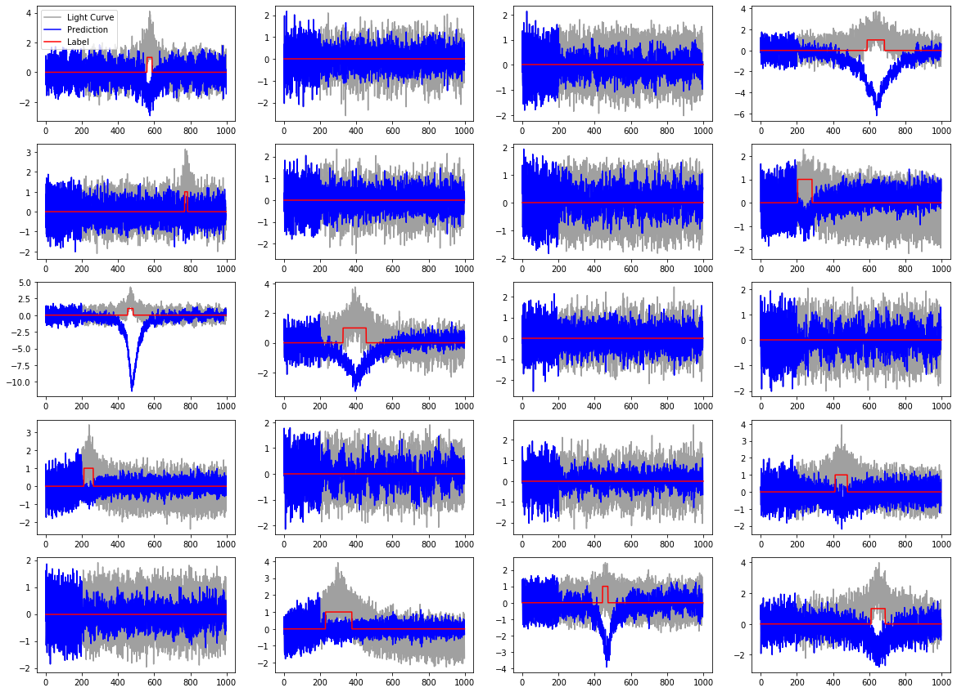
ARIMA (0,0,2) - Prediction (Best Performing)

Slide 22
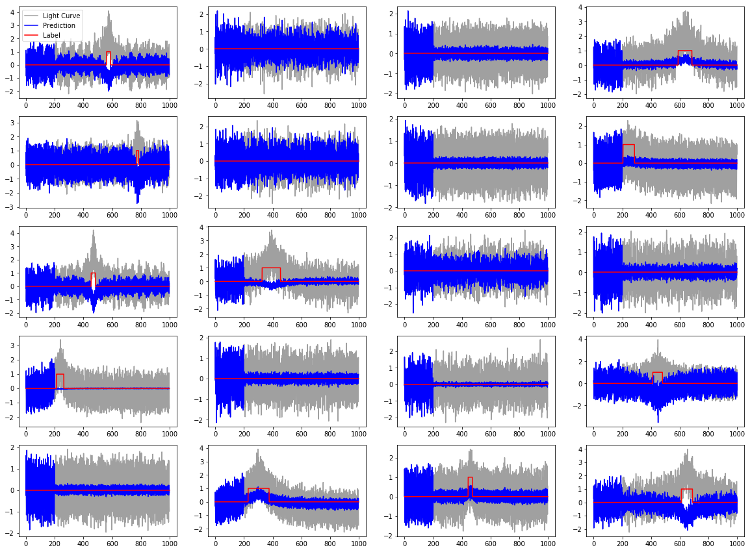
ARIMA (1,0,0) - Prediction

Slide 23
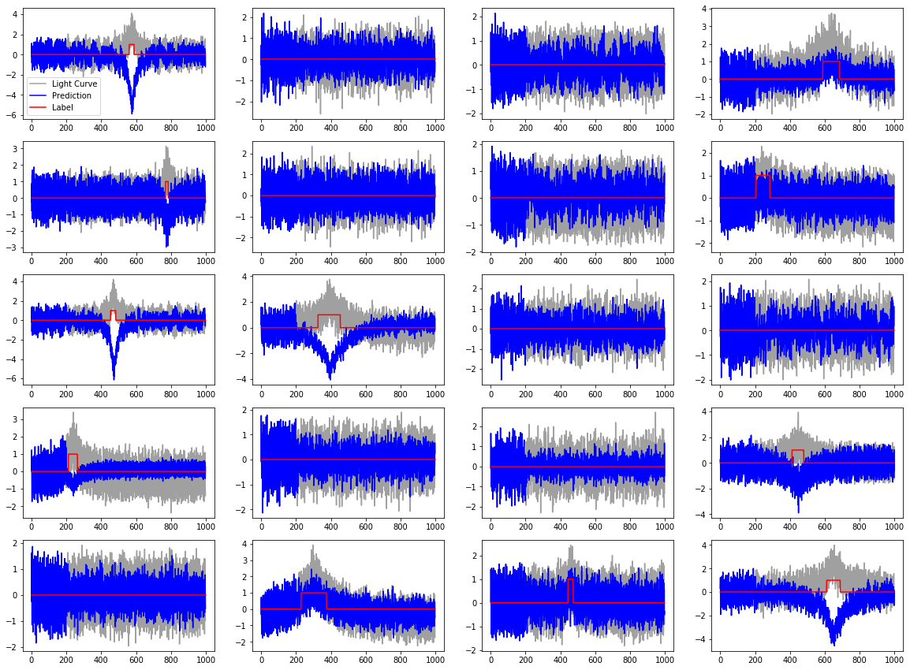
ARIMA (1,0,1) - Prediction

Slide 24
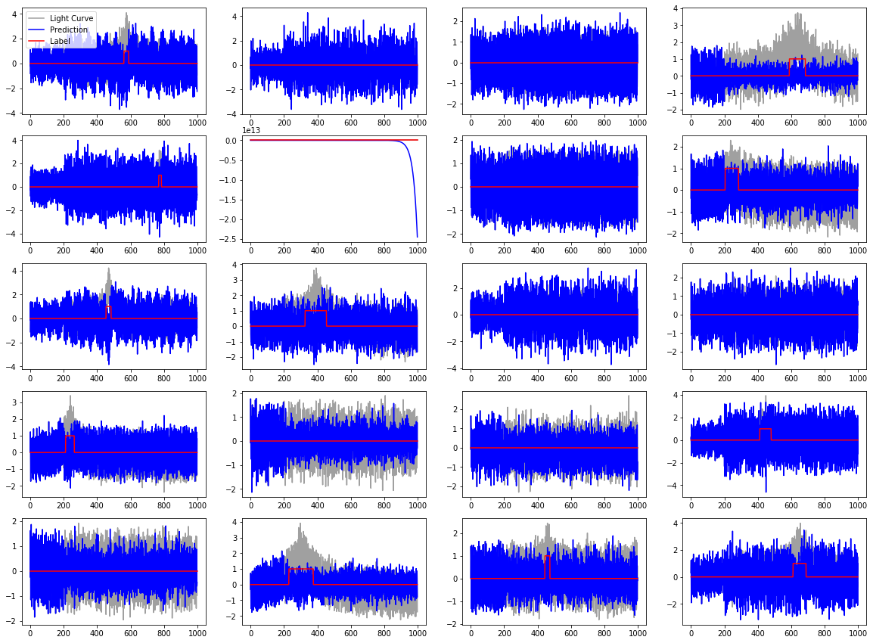
ARIMA (1,1,1) - Prediction (Explodes)

Slide 25
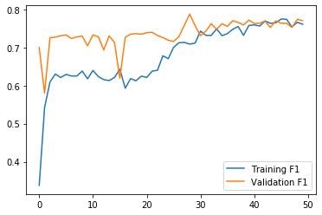
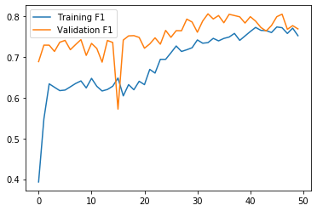
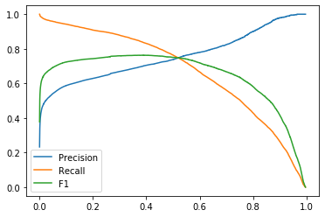
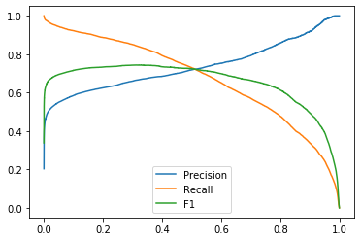
GRU-ARIMA Prediction Simulation Results
ARIMA (1,0,0)
Best F1: 0.7631
Threshold: 0.37
ARIMA (1,0,1)
Best F1: 0.7441
Threshold: 0.31

Slide 26
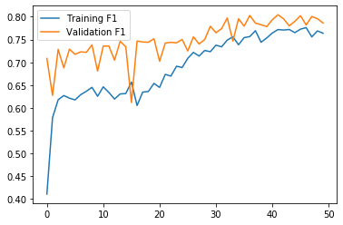
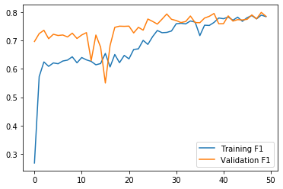
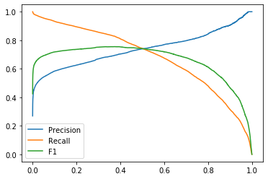
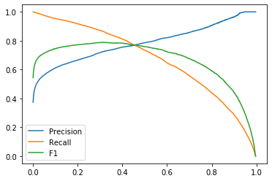
GRU-ARIMA Prediction Simulation Results
ARIMA (0,0,1)
Best F1: 0.7556
Threshold: 0.37
ARIMA (0,0,2)
Best F1: 0.7888
Threshold: 0.31

Slide 27
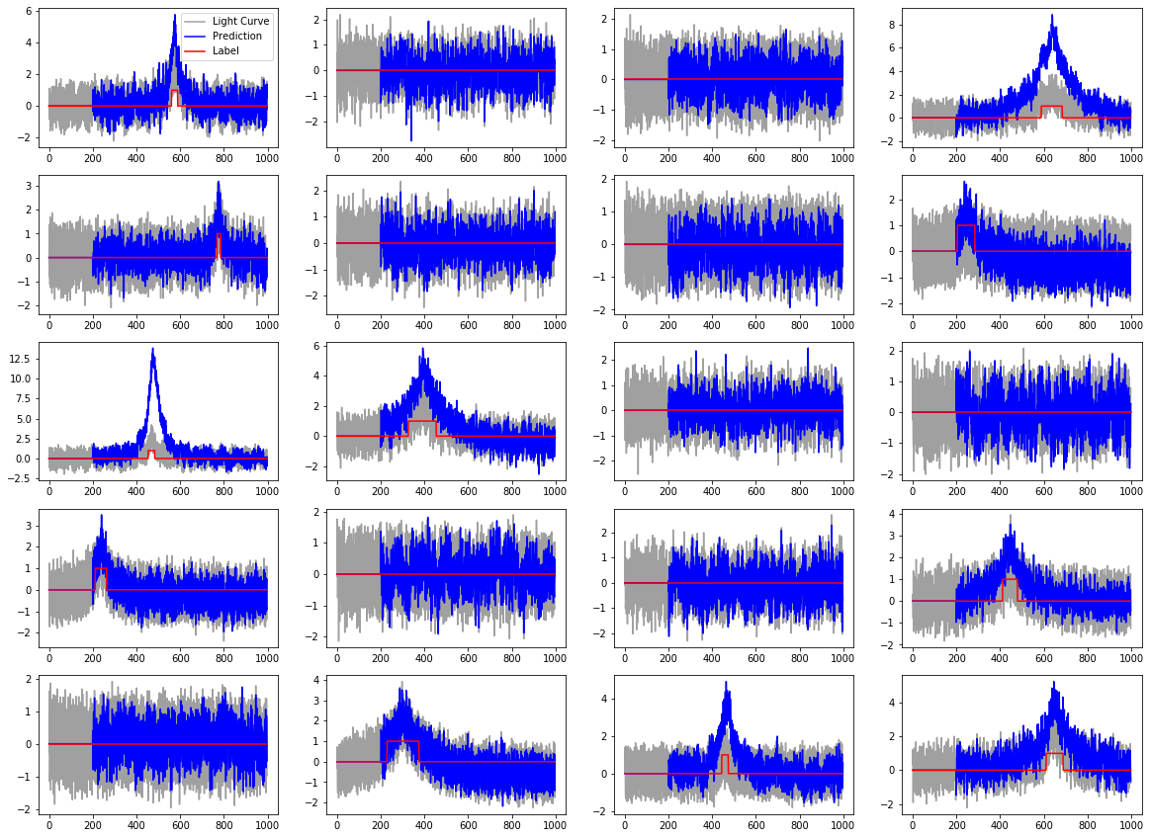
ARIMA (0,0,2) - Residuals

Slide 28
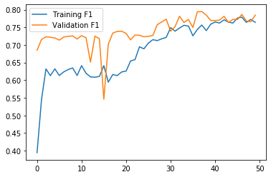
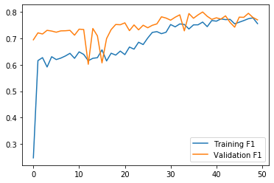
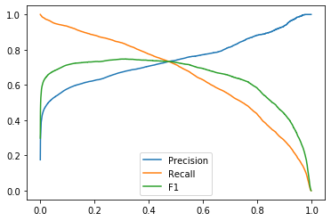

GRU-ARIMA Residual Simulation Results
ARIMA (1,0,0)
Best F1: 0.7727
Threshold: 0.38
ARIMA (1,0,1)
Best F1: 0.7472
Threshold: 0.30

Slide 29
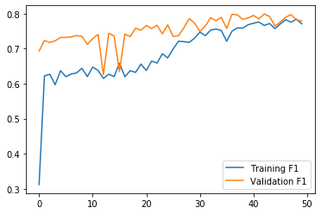
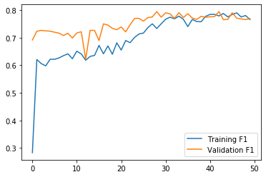
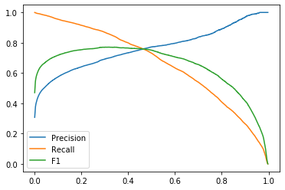
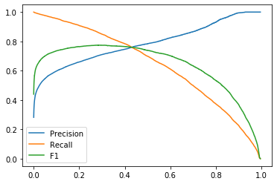
GRU-ARIMA Residual Simulation Results
ARIMA (0,0,1)
Best F1: 0.7711
Threshold: 0.32
ARIMA (0,0,2)
Best F1: 0.7742
Threshold: 0.28

Slide 30
GRU-ARIMA Prediction MOA Results
ARIMA (0,0,2) that performed best on simulation missed an event on MOA dataset and did not perform the best
Residuals seemed to have cleaner signals over predictions
ARIMA (1,0,1) performed the best and has stronger signal than baseline

Slide 31

GRU-ARIMA (0,0,1) Predictions GRU-ARIMA(0,0,1) Residual

Slide 32
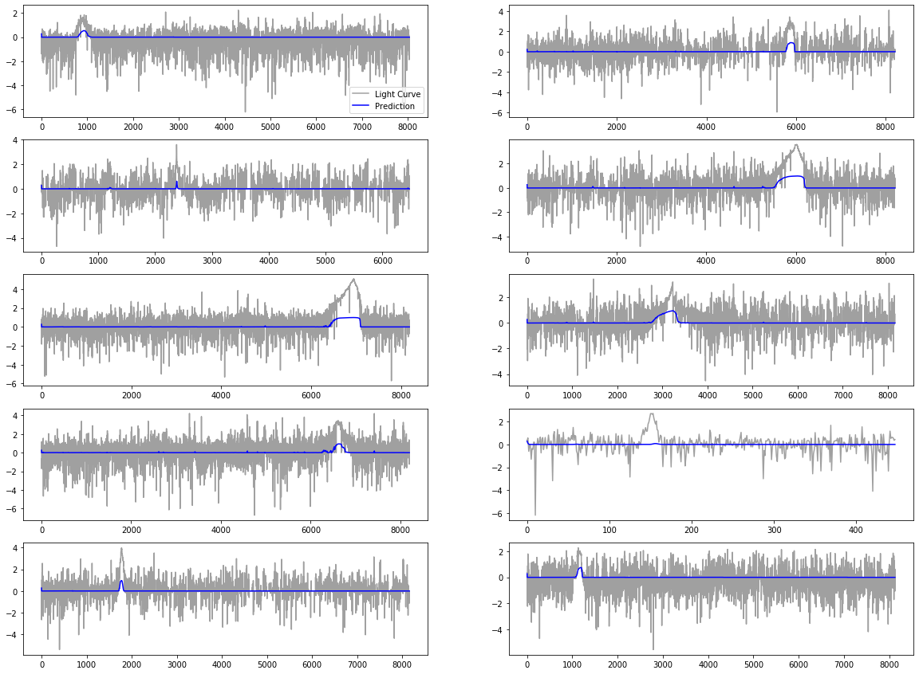
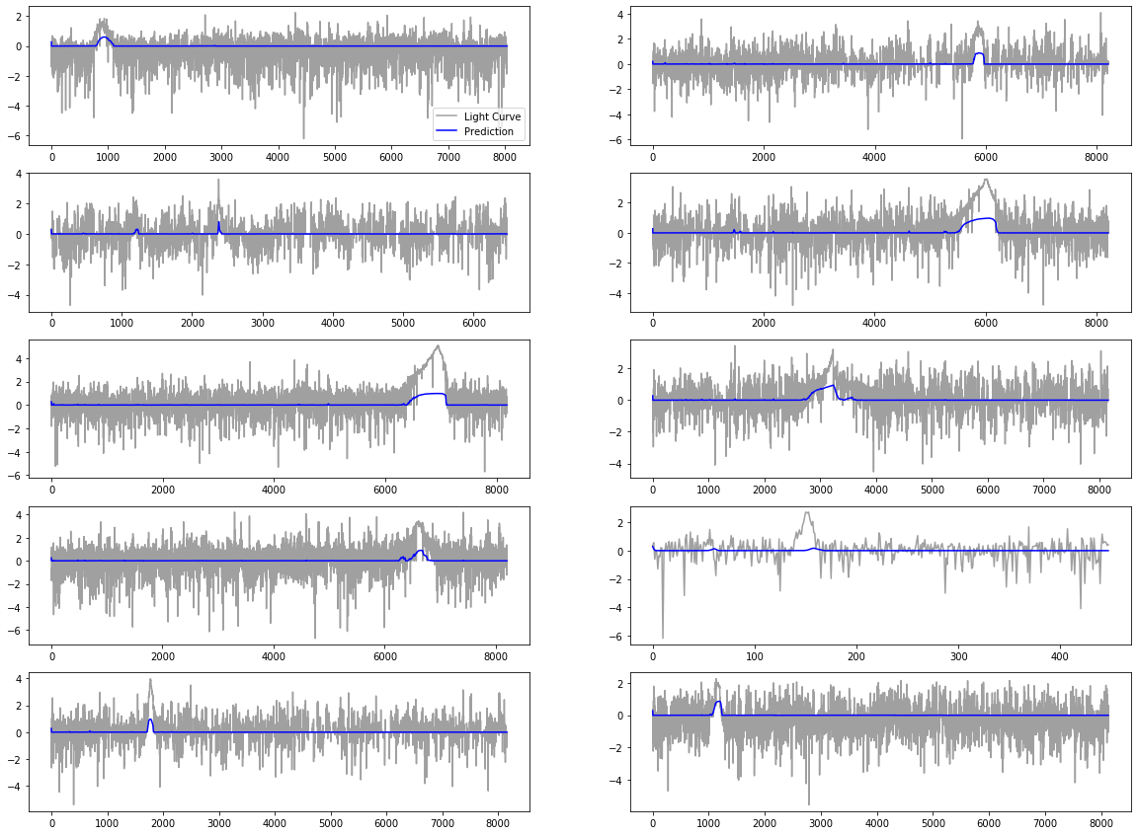
GRU-ARIMA (0,0,2) Predictions GRU-ARIMA(0,0,2) Residual

Slide 33
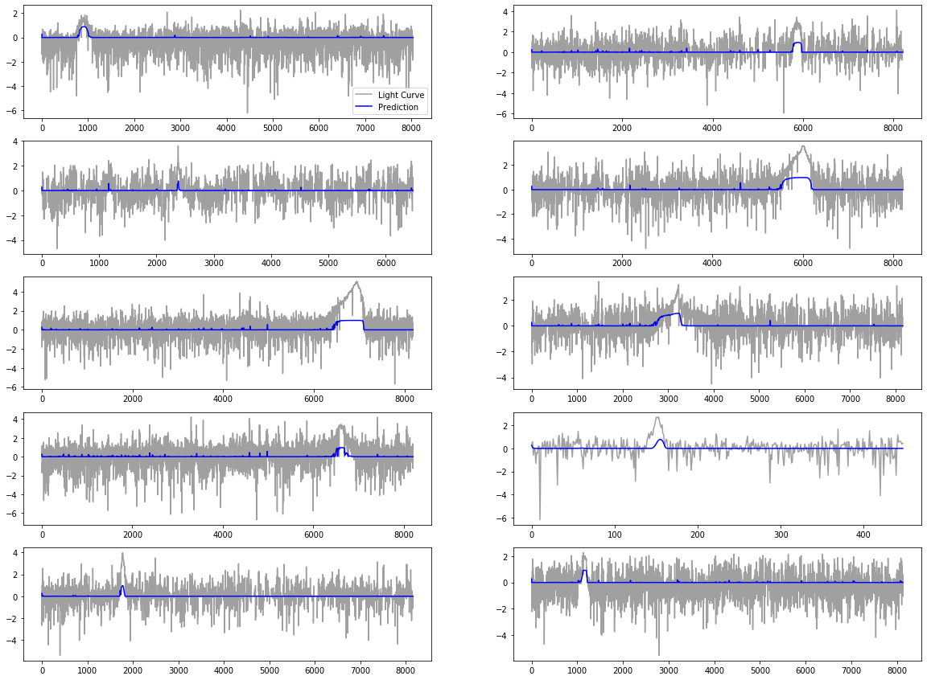

GRU-ARIMA (1,0,0) Predictions GRU-ARIMA(1,0,0) Residual

Slide 34

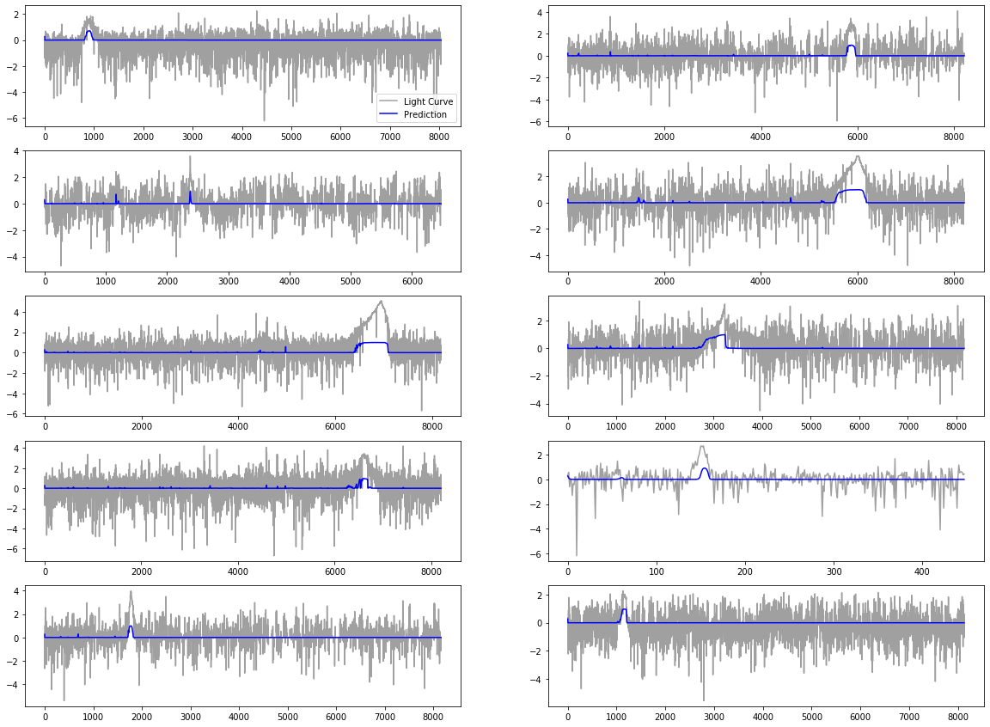
GRU-ARIMA (1,0,1) Predictions GRU-ARIMA(1,0,1) Residual

Slide 35
GRU Baseline GRU-ARIMA(1,0,1) Residual

Slide 36
Gaussian Process
Trained on 1 subset with 1000 time segments
Entire test set used for mean and standard deviation
1 test subset with 1000 time segments used for covariance
Kernels used -
ExpSineSquared
Mixed kernel (Constant + Matern + White)
Matern
RationalQuadratic
RBF
SpectralMixture
Residual / standard deviation fed into RNN

Slide 37
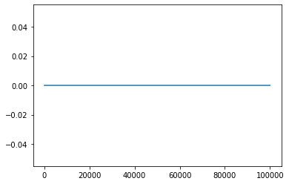
Gaussian Process - Mean
Zero mean for every kernel

Slide 38
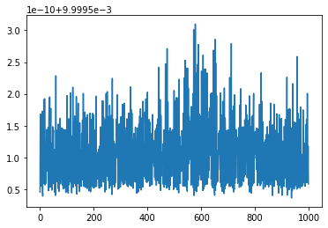
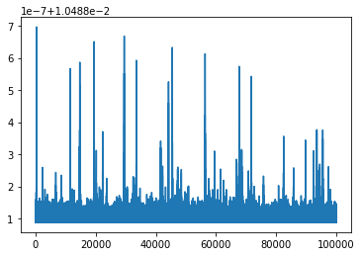
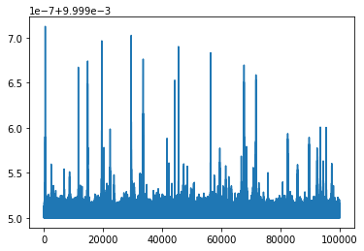

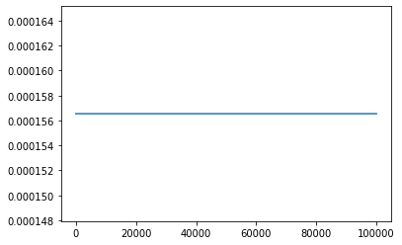
Gaussian Process - Standard deviation
Exp Sine Squared
Mixed kernel
Matern
Rational Quadratic
RBF
Spectral Mixture

Slide 39
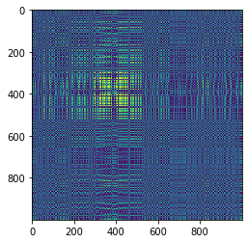


Gaussian Process - Covariance Matrix
Exp Sine Squared
Mixed kernel
Matern
Rational Quadratic
RBF
Spectral Mixture

Slide 40

Gaussian Process - Confidence region
The difference in the confidence bound at different timepoints are at a very minute scale thus unobservable

Slide 41

Gaussian Process - Residual / Standard deviation
Same for every kernel

Slide 42


Gaussian Process-GRU Residual result
Kernel - Rational Quadratic
Best threshold: 0.99999994
Best F1-Score: 0.5258975450546332

Slide 43


Slide 44

Gaussian Process-GRU Evaluation graphs

Slide 45
Summary
Detect microlensing events using RNN, RNN-ARIMA, and RNN-Gaussian Process models
These models can be used as an early warning detection system or for microlensing event labeling

Slide 46
Appendix

Slide 47
MOA light curves presented
gb18/R/9/gb18-R-9-4-30462.phot
gb18/R/9/gb18-R-9-6-137778.phot
gb18/R/9/gb18-R-9-3-87282.phot
gb18/R/9/gb18-R-9-2-135512.phot
gb18/R/9/gb18-R-9-5-156745.phot
gb18/R/9/gb18-R-9-0-85169.phot
gb18/R/2/gb18-R-2-7-215114.phot
gb18/R/2/gb18-R-2-4-119901.phot
gb18/R/2/gb18-R-2-3-72409.phot
gb18/R/2/gb18-R-2-2-45059.phot

Slide 48
MOA Data Acknowledgement
This paper makes use of data obtained by the MOA collaboration with the 1.8 metre MOA-II telescope at the University of Canterbury Mount John Observatory, Lake Tekapo, New Zealand. The MOA collaboration is supported by JSPS KAKENHI grant and the Royal Society of New Zealand Marsden Fund. These data are made available using services at the NASA Exoplanet Archive, which is operated by the California Institute of Technology, under contract with the National Aeronautics and Space Administration under the Exoplanet Exploration Program.

